Slide 1



AWS – solution architect – final project
Visual search application
Instructors: Mr. Anas Bakleh,
Mr. Mohammed Alhakami

Slide 2

Project Team
Group members
Saif Aljaafari
Abdulaziz Alnasser
Bader Alotaibi
Speaker:
Saif Aljaafari

Slide 3
Provide a visual search service that finds similar objects to the input
Project’s idea
Use AWS services to implement this solution
Utilize machine learning to provide a high-quality result
Help Users with finding similar objects to their liking
Speaker:
Saif Aljaafari

Slide 4
Train models with different objects such as furniture, cars, appliances, etc.
Future plans
Implement a vendor locator system that provides all the stores with the found results
Implement a real time solution with a mobile camera
Implement different AWS resources to provide a better user experience
Speaker:
Saif Aljaafari

Slide 5
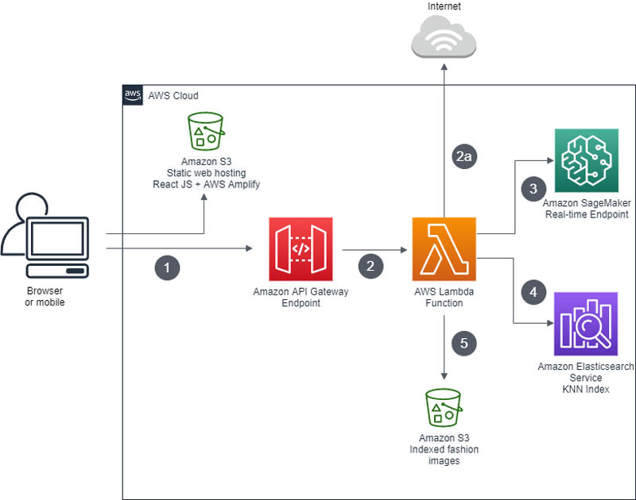
Cloud Diagram
Speaker: Abdulaziz AlNasser

Slide 6

Conclusion
Implementing this project has allowed us to have a better understanding on how to implement a project on the cloud, AWS offers different resources that made it the implementation process intuitive. There are still many resources that can be utilized to improve our project and we hope that we will be able to experiment with them in the future.
Speaker:
Abdulaziz AL Nasser

Slide 7
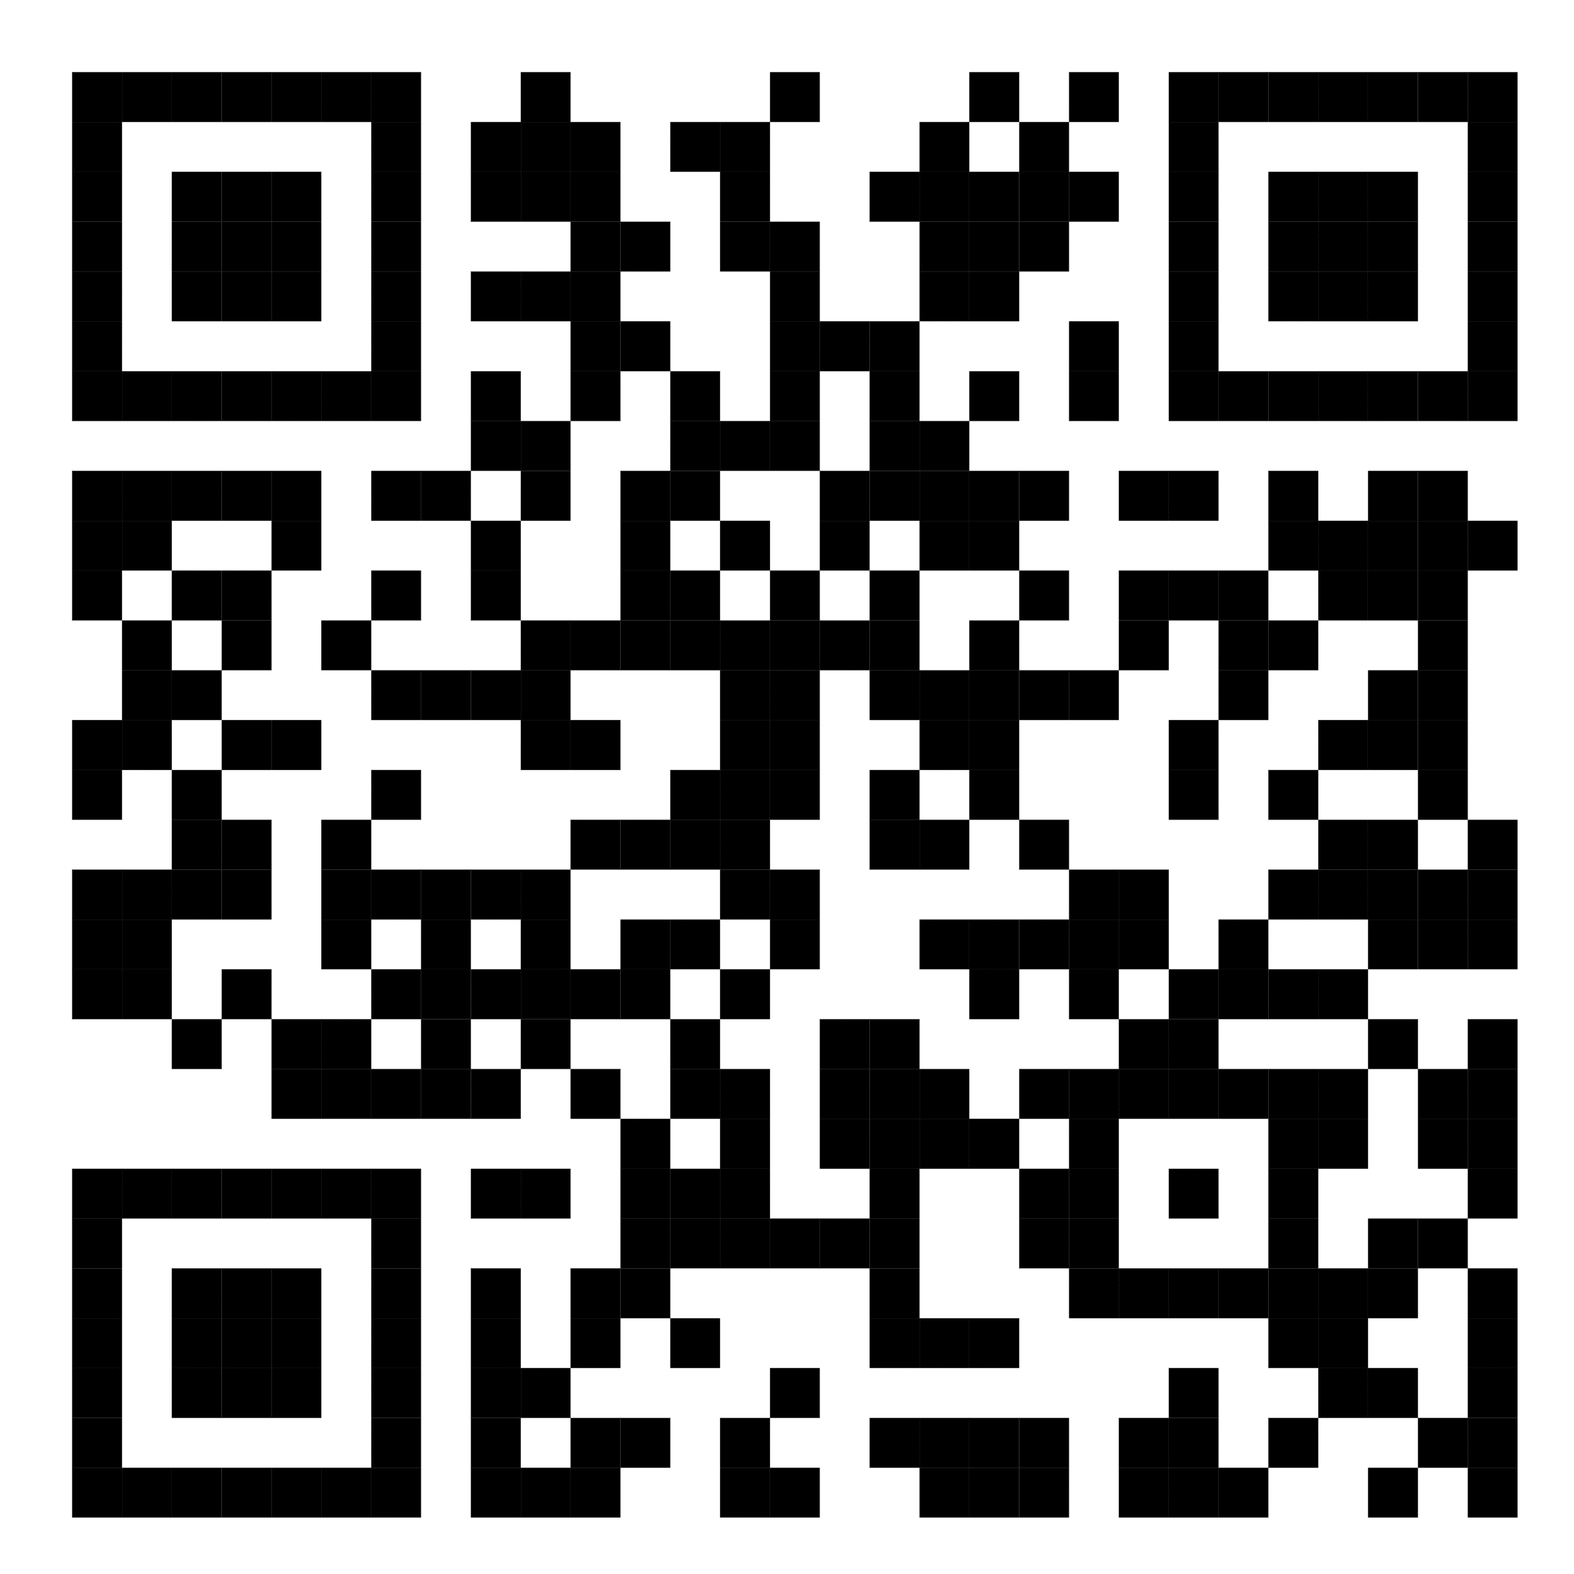
Live demonstration
Speaker:
Bader Alotaibi

Slide 8

Thank you for listening!
Any questions?

